Slide 1
Basic Concepts of Information Theory
Introduction to Information Retrieval
Shubhra Kanti Karmaker (Santu)
Many of the slides have been indirectly/ directly adopted from Prof. ChengXiang Zhai’s “Advanced Topics in Information Retrieval” Course at UIUC. http://times.cs.uiuc.edu/course/510f17/ and the textbook “Text Data Management and Analysis: A Practical Introduction to Information Retrieval and Text Mining” by Cheng Xiang Zhai and Sean Massung”

Slide 2
Information Theory Basics
Random Variable
Outcome of a statistical experiment
Entropy
Measuring uncertainty of a random variable
Kullback-Leibler divergence
Comparing two distributions
Mutual Information
Measuring the correlation of two random variables

Slide 3

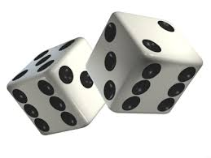
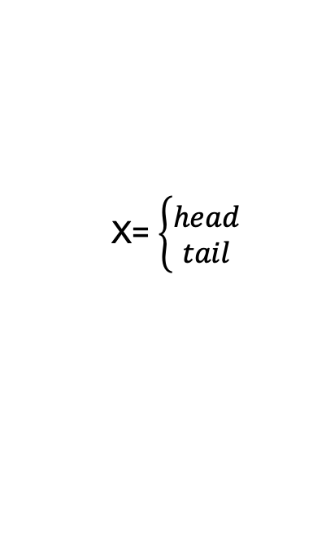
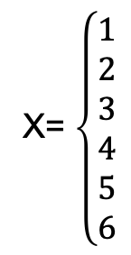
Random Variable
Outcome of a statistical experiment
Probabilistic in nature
X= $\left\{\begin{aligned}1 \\ 2 \\ 3 \\ 4 \\ 5 \\ 6\end{aligned}\right.$
X= $\left\{\begin{aligned}head \\ tail\end{aligned}\right.$

Slide 4
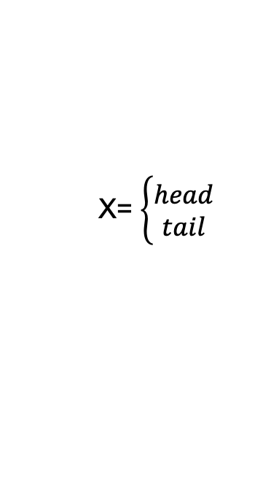
Entropy
Entropy H(X) measures the uncertainty/randomness of random variable X
The more uncertain a random variable is, the higher the entropy
If X is always head, we don’t need to represent any information and
H(X) = 0.
X= $\left\{\begin{aligned}head \\ tail\end{aligned}\right.$
If X is always tail, we don’t need to represent any information and
H(X) = 0.
What if 50/50 chance??

Slide 5
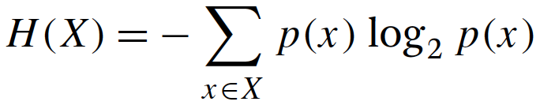
Entropy - Definition
H(X), is a measure of expected number of bits needed to represent the outcome of an event x ∼ X.

Slide 6
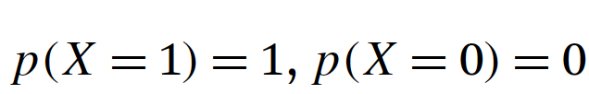
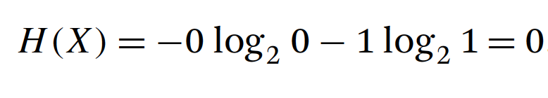
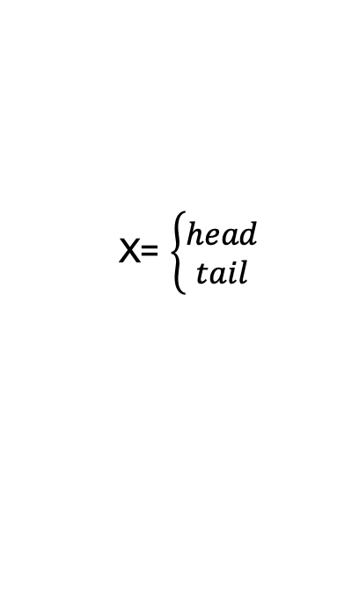
Entropy - Definition
H(X), is a measure of expected number of bits needed to represent the outcome of an event x ∼ X.
X= $\left\{\begin{aligned}head \\ tail\end{aligned}\right.$

Slide 7
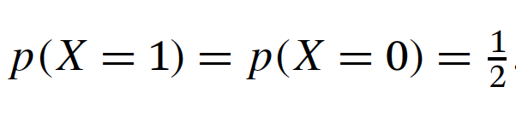
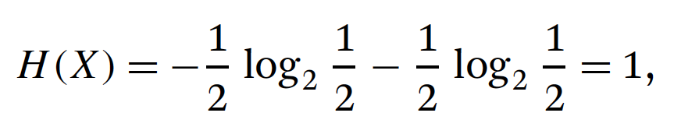
Entropy - Definition
H(X), is a measure of expected number of bits needed to represent the outcome of an event x ∼ X.
X= $\left\{\begin{aligned}head \\ tail\end{aligned}\right.$

Slide 8
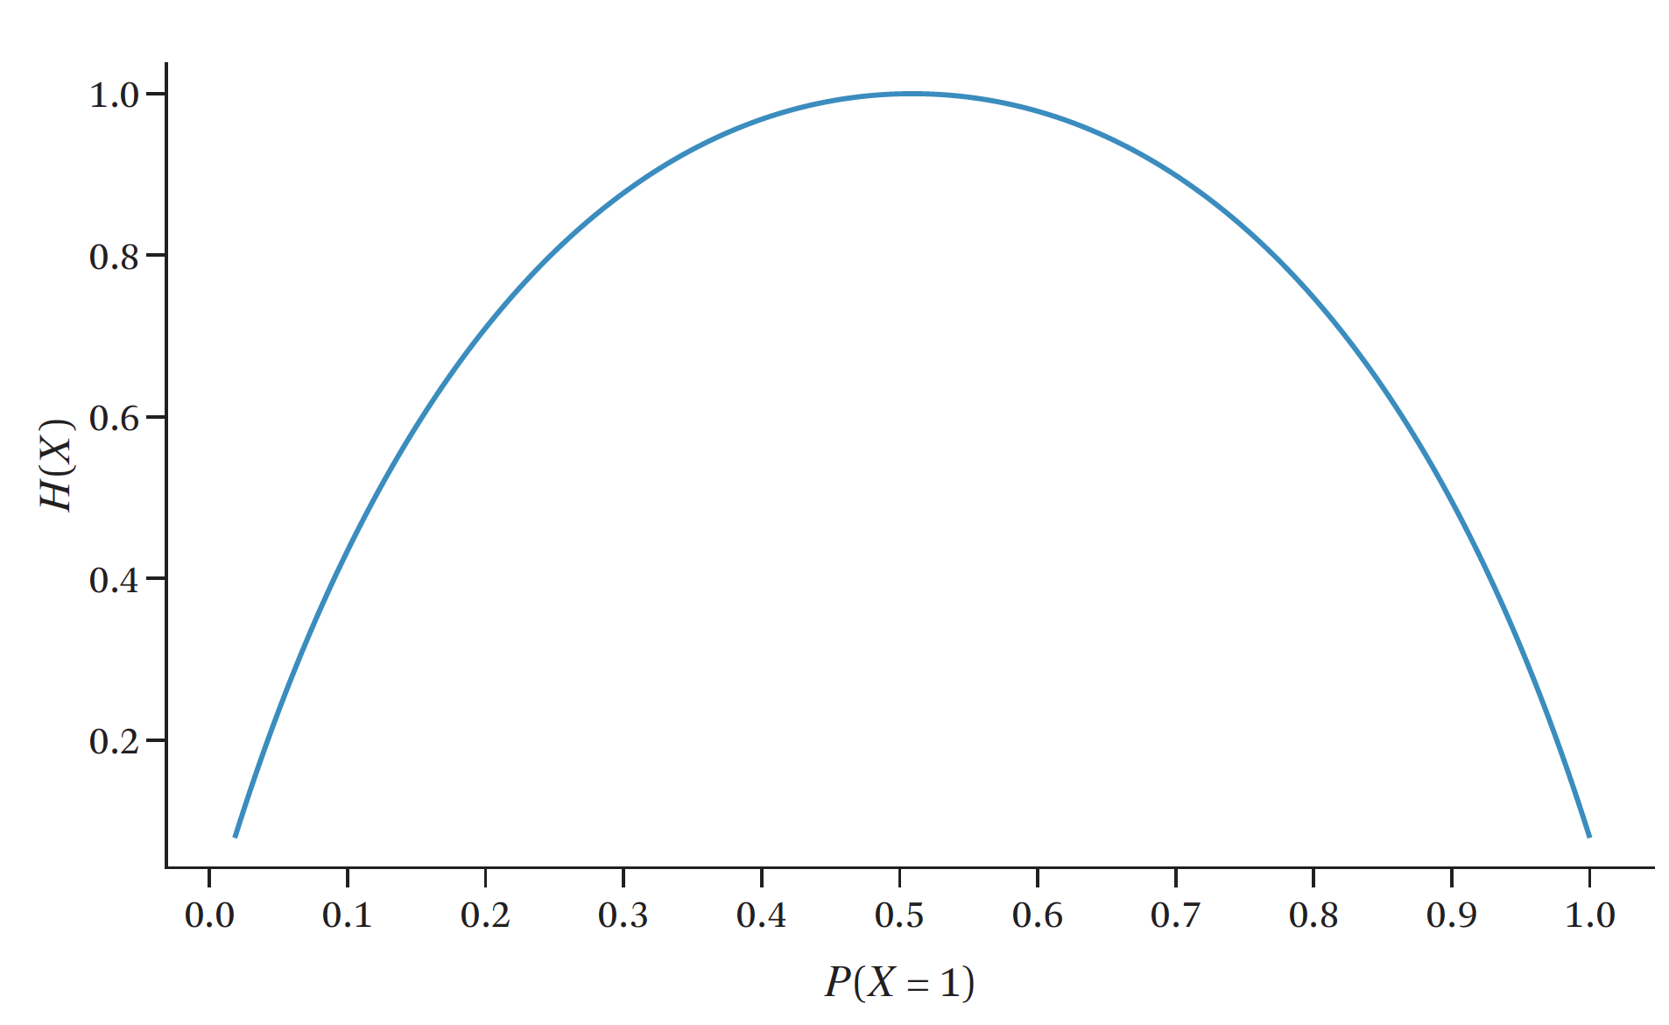
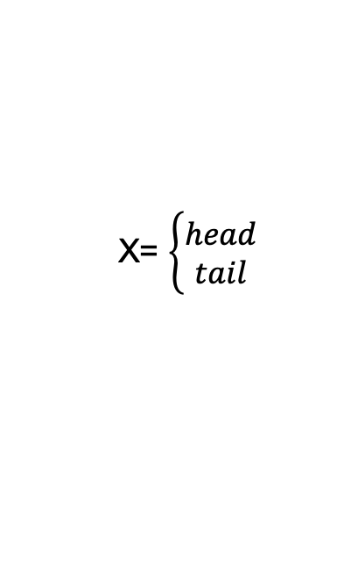
Entropy - Definition
X= $\left\{\begin{aligned}head \\ tail\end{aligned}\right.$

Slide 9
Entropy – More Interpretation
Measures the “amount of information” in X
Minimum average number of bits to compress values of X
A fair coin has the maximum information, and is hardest to compress
A biased coin has some information, and can be compressed to <1 bit on average
A completely biased coin has no information, and needs only 0 bit

Slide 10
Entropy – Properties
Minimum value of H(X): 0
Fully Biased Coin
Maximum value of H(X): log M, where M is the number of possible values for X
Fair Dice
Related to coding of information
Information of x =“# bits to code x”
= - log p(x)

Slide 11
Entropy for Information Retrieval
Lets pick a random document
W = 1 if the word occurs and W = 0 otherwise
H(W_{the})?
H(W_{computer})?
H(W_{a})?
H(W_{auburn})?
H(W_{cndknd})?

Slide 12
Entropy for Information Retrieval
Lets pick a random document
W = 1 if the word occurs and W = 0 otherwise
H(W_{the})?
H(W_{computer})?
H(W_{a})?
H(W_{auburn})?
H(W_{cndknd})?
H(“the”) vs H(“computer”)
H(“the”) vs H(“a”)
H(“the”) vs H(“cndknd”)
H(“auburn”) vs H(“computer”)

Slide 13
Conditional Entropy
The conditional entropy of a random variable Y given another X, expresses how much extra information one still needs to supply on average to communicate Y given that the other party knows X

Slide 14
Conditional Entropy for Information Retrieval
Feature selection
If we use only a few words to classify docs, what kind of words should we use?
P(Topic| “computer”=1) vs P(Topic | “the”=1): which is more random?
Text compression
Some documents (less random) can be compressed more than others (more random)
Can we quantify the “compressibility”?

Slide 15
Conditional Entropy
H(Topic=TV | “samsung”=1)?
H(Topic=TV| “the”=1)?
H(Topic= Tornedo | “samsung”=1)?

Slide 16
Conditional Entropy
H(Topic=TV | “samsung”=1)?
Lower
H(Topic=TV| “the”=1)?
Same
H(Topic=Tornedo | “samsung”=1)?
Lower

Slide 17
Information Gain
Reduction in Entropy
H(Topic) - H(Topic| X)
H(Topic=TV) - H(Topic=TV| “samsung”=1)
H(Topic=TV) - H(Topic=TV| “the”=1)

Slide 18
Information Gain
H(Topic=Search Engine) - H(Topic= Search Engine | “google”=0)
H(Topic= Search Engine) - H(Topic= Search Engine | “human”=0)

Slide 19
Information Gain
H(“trump”=1) - H(“trump”=1| Topic= US Election)
H(“trump”= 1) - H(trump = 1 | Topic != US Election)

Slide 20
Cross Entropy H(p,q)
What if we encode X with a code optimized for a wrong distribution q?
Expected # of bits=?
Intuitively, H(p,q) ≥ H(p), and mathematically,

Slide 21
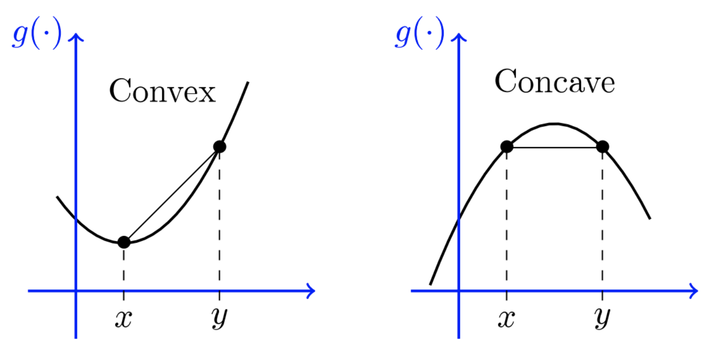
Convex Vs Concave function

Slide 22
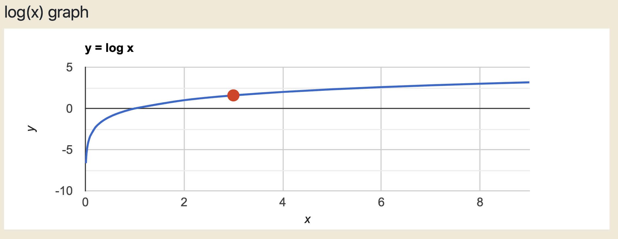
How about Logarithm?

Slide 23
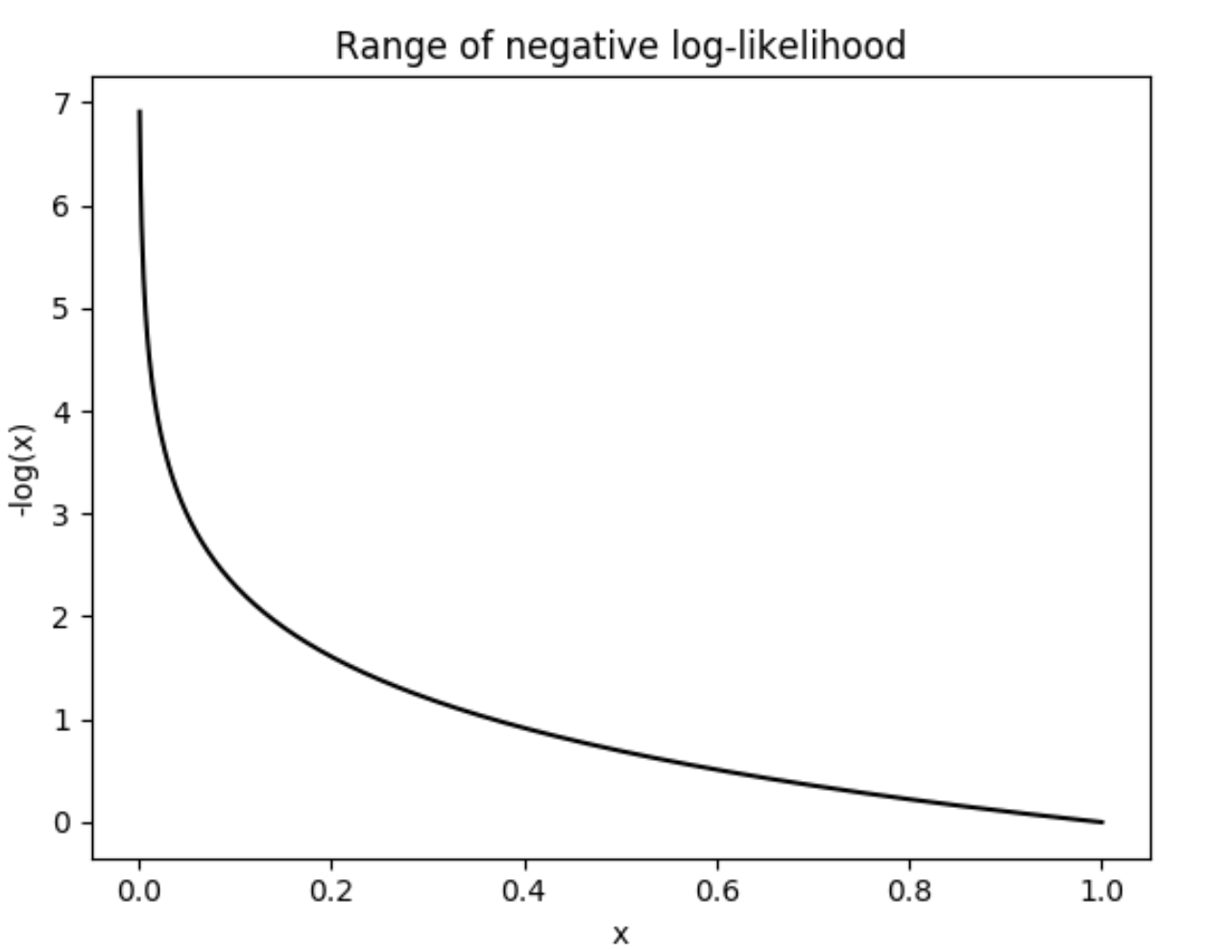
How about Negative of Logarithm?

Slide 24
Cross Entropy H(p,q)
What if we encode X with a code optimized for a wrong distribution q?
Expected # of bits=?
Intuitively, H(p,q) ≥ H(p), and mathematically,

Slide 25
Kullback-Leibler Divergence D(p||q)
What if we encode X with a code optimized for a wrong distribution q?
How many bits would we waste?
Properties: (Homework)
- D(p||q)≥0
- D(p||q)≠D(q||p)
- D(p||q)=0 iff p=q
Relative entropy
KL-divergence is often used to measure the
distance between two distributions
Interpretation:
Fix p, D(p||q) and H(p,q) vary in the same way
If p is an empirical distribution, minimize D(p||q) or H(p,q) is equivalent to maximizing likelihood

Slide 26

Likelihood of the Observed Data
How likely it is that a single event /series of events will happen?
What is the probability that Color = red and Size = circle?
What is the probability that Color = green and Size = circle?

Slide 27

Likelihood of the Observed Data
How likely it is that a single event /series of events will happen?
What is the probability that Color = green and Size = circle?
What is the probability that we will see a square followed by a circle?
What is the probability that we will see a square followed by a green circle?

Slide 28
Cross Entropy, KL-Div, and Likelihood
Example: X ∈{“H”,“T”}
Y=(HHTTH)

Slide 29
Mutual Information I(X;Y)
Comparing two distributions: p(x,y) vs p(x) p(y)
Properties:
I(X;Y)≥0
I(X;Y)=I(Y;X)
I(X;Y)=0 iff X & Y are independent
Interpretations:
- Measures how much reduction in uncertainty of X given info. about Y
- Measures correlation between X and Y
- Related to the “channel capacity” in information theory
Examples:
I(Topic; “computer”) vs. I(Topic; “the”)?
I(“computer”, “program”) vs I(“computer”, “baseball”)?

Slide 30
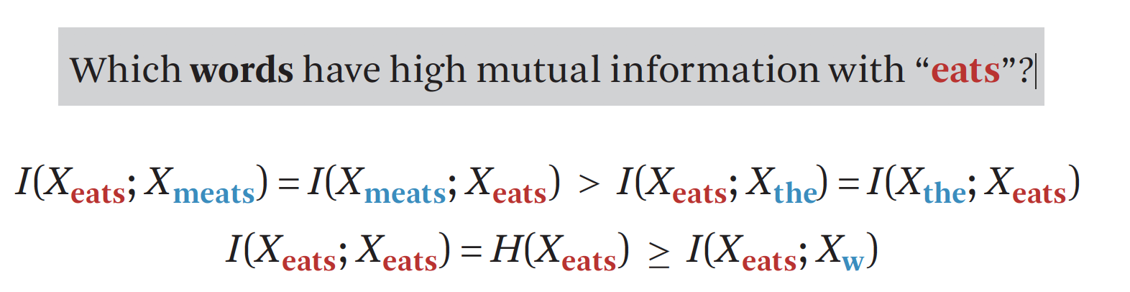
Mutual Information I(X;Y)
Whenever eats occurs, what other words also tend to occur?
Mutual information between a word and itself is the largest,
which is equal to the entropy of the word

Slide 31
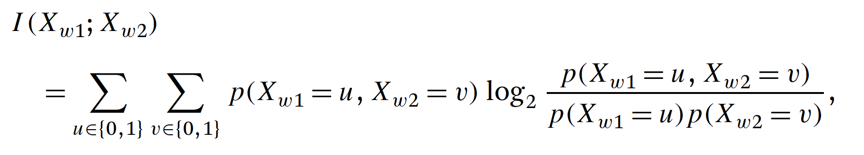
Computing Mutual Information
Any connection with KL Divergence?

Slide 32
Mutual Information and KL Divergence
Numerator of the fraction is the observed joint distribution
Denominator is the Expected joint distribution if they are independent
KL-divergence quantifies the difference between these two distributions
KL-divergence measures the divergence of the actual joint distribution from the expected distribution under an independence assumption. The larger the divergence is, the higher the mutual information would be.

Slide 33
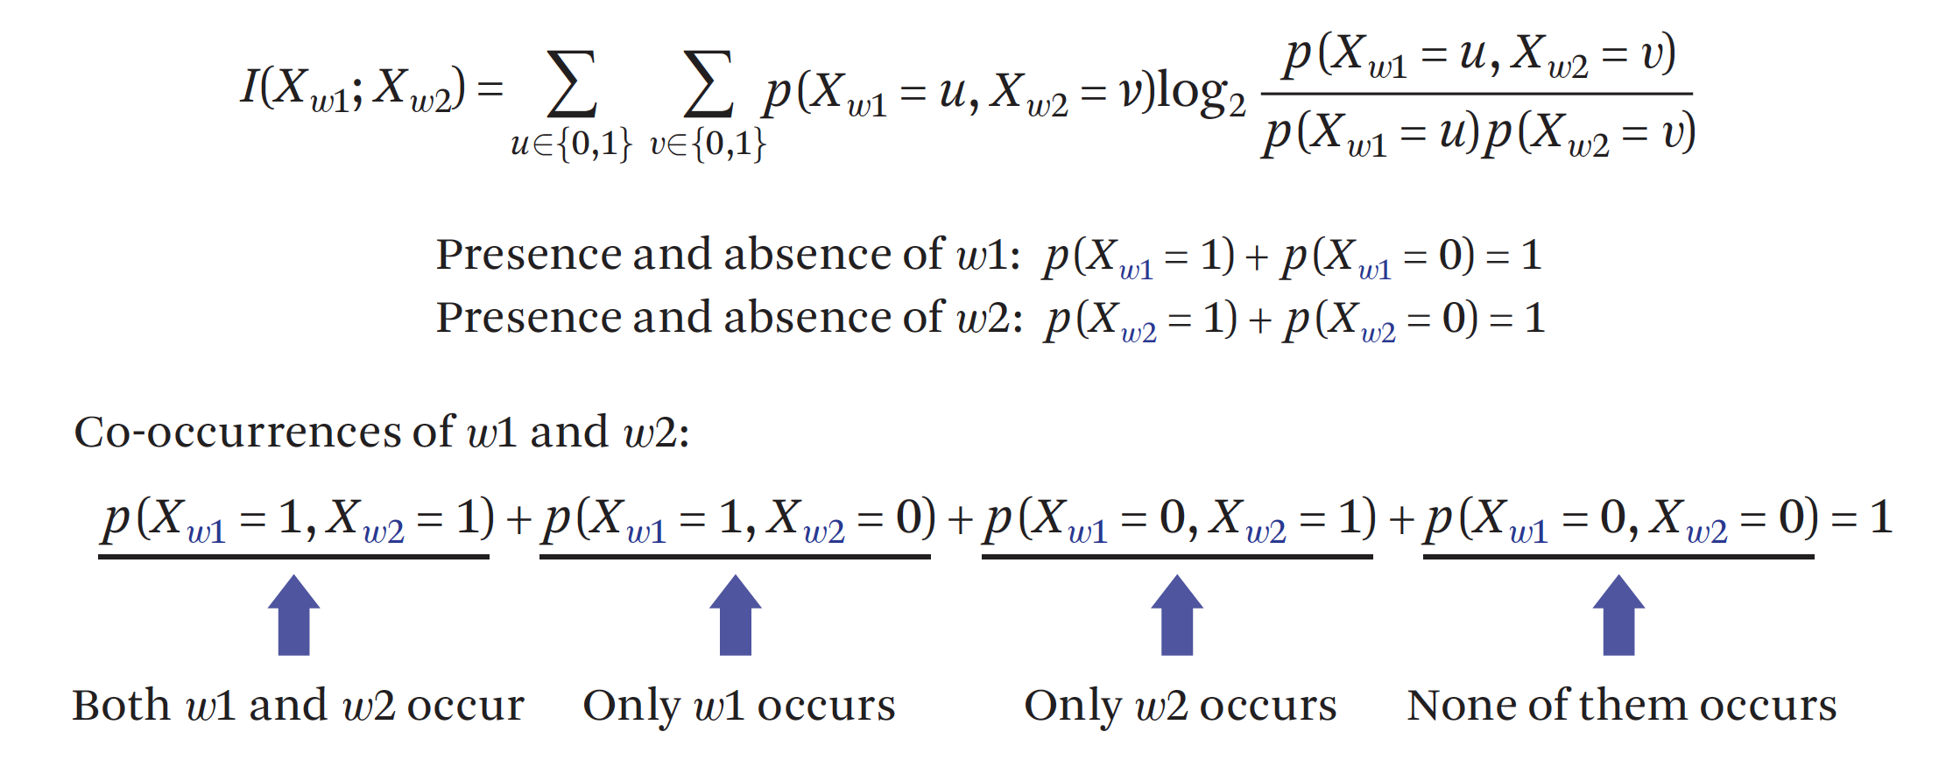
Computing Mutual Information
Associated Probabilities:

Slide 34
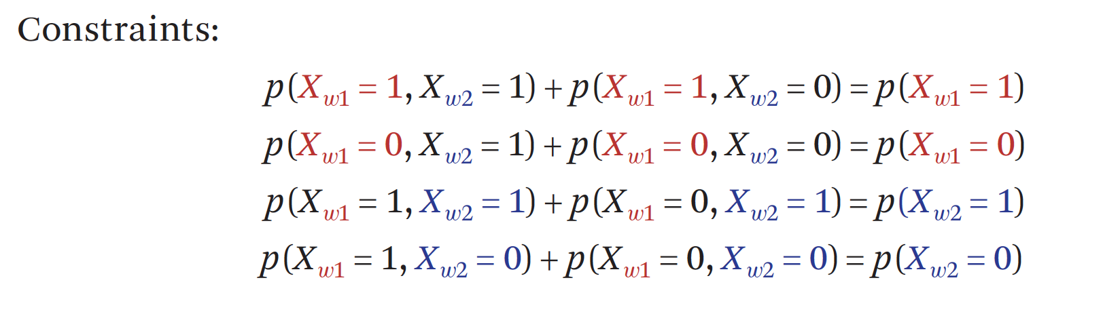
Computing Mutual Information

Slide 35
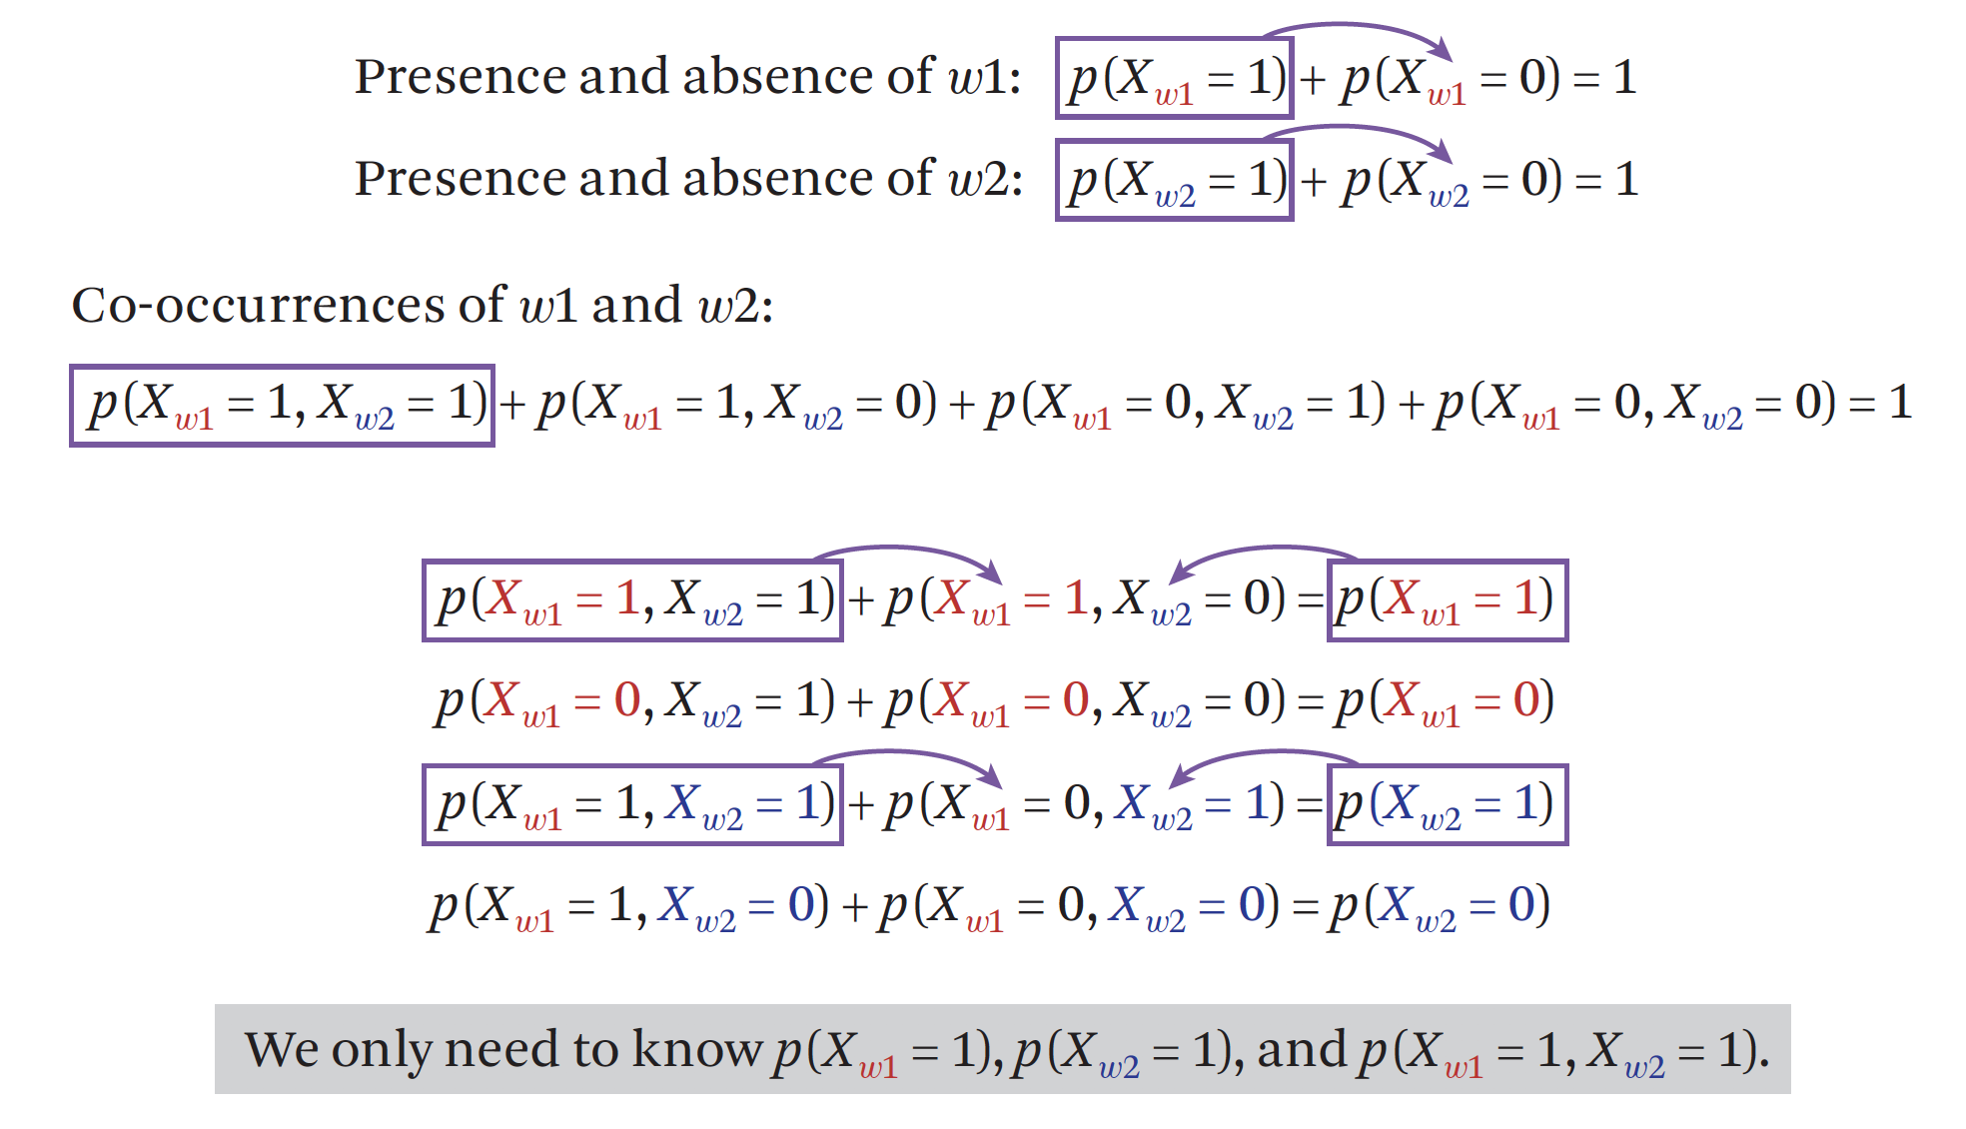
Computing Mutual Information
What we need to know

Slide 36
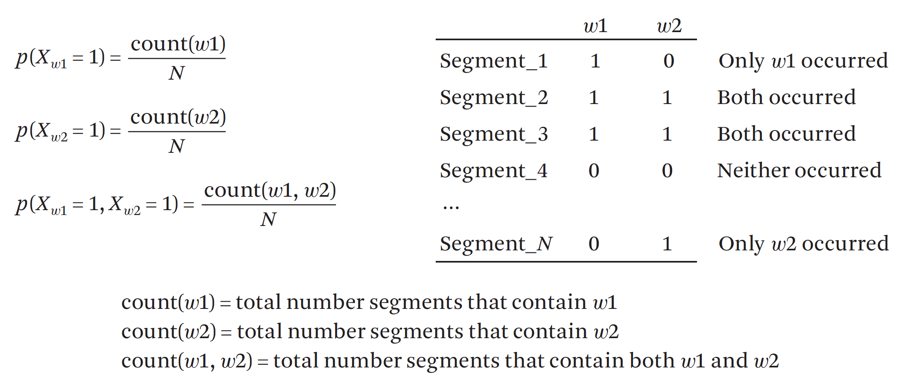
Computing Mutual Information
Estimating the Probabilities

Slide 37
What You Should Know
Information theory concepts: entropy, cross entropy, relative entropy, conditional entropy, KL-div., mutual information
Know their definitions, how to compute them
Know how to interpret them
Know their relationships

